Slide 1
Algoritma & Pemrograman
Structures
Prepared by
Frans Panduwinata, S.Kom, M.T

Slide 2
Introduction
Structures are used when you want to process data of multiple data types but you still want to refer to the data as a single entity.
For EXAMPLE:
  You might want to process information on students in the categories of name and marks (grade percentages).
  Here you can declare the structure ‘student’ with the fields ‘name’ and ‘marks’, and you can assign them appropriate data types.
  These fields are called members of the structure.

Slide 3
Introduction (cont)
EXAMPLE:
struct student // A
{
char name[30];
float marks;
}student1, student2; // B
  Statement A defines the structure type student. It has two members: name and marks.
  Statement B defines two structure variables: structure1 and structure2, struct student is the data type, just as int and student1 is the variable.

Slide 4
Introduction (cont)
A member of the structure is referred to in the form of structurename.membername.
EXAMPLE:
main ( )
{
struct student student3;
char s1[30];
float f;
getline(cin, s1);
cin>>f;
student1.name = s1;
student2.marks = f;
cout<<“Name is “<<student1.name;
cout<<“Marks are “<<student2.marks;
}

Slide 5
Complex Structure Definitions
EXAMPLE:
struct address
{
char plot[30], char street[30],
char city[30];
}
struct student
{
char name[30];
float marks;
struct address adr;
}
When a structure is a member of another structure it is called a nested structure.

Slide 6
Complex Structure Definitions (cont)
EXAMPLE: (cont)
main ( )
{
struct student student1;
struct student class[20];
class[1].marks = 70;
class[1].name = " Anil ";
class[1].adr.plot = "7 ";
class[1].adr.street = " My Road";
class[1].adr.city = "mumbai";
cout<<“Marks are “<<class[1].marks;
cout<<“Name are “<<class[1].name;
cout<<“adr.plot is “<<class[1].adr.plot;
cout<<“adr.street is “<<class[1].adr.street;
cout<<“adr.city is “<<class[1].adr.city;
}
You can define structures of arrays or arrays of structures, and the members are referred to using dot notations.

Slide 7
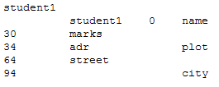
Memory Allocation to Structure
For each structure, variable memory is allocated. The following EXAMPLE give the memory layout of the structure student1.
EXPLANATION:
Suppose the base address of the
allocations is 0; then the first
member name starts from 0.
Since name has 30 characters,
the second member, marks, starts
from location 30; marks occupies
4 bytes.
The third member, adr, starts from
location 34, so the first member of adr starts from location 34.
Period plot occupies 30 bytes, so street starts at 64. city starts at 94.
print the addresses of the members:
cout<<&student1.marks;

Slide 8
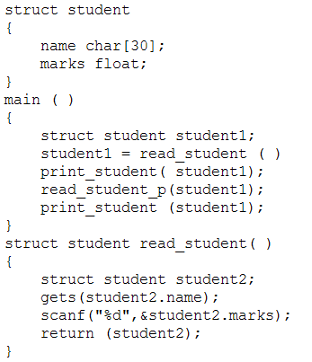
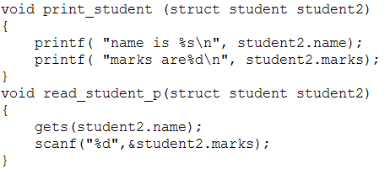
Programming with Structures
You can write programs with structures by using modular programming.

Slide 9
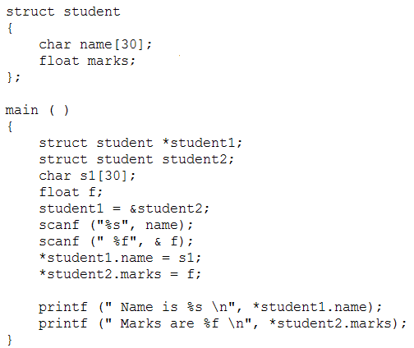
Structure Pointers
You can process the structure using a structure pointer.
Alternative notation:
student1-> name = s1;
student2-> marks = f;

Slide 10
Exercises
Write a program using structure, pointers and functions.
Amount of data: 5
Data 1: 7
Data 2: 10
Data 3: 51
Data 4: 19
Data 5: 1
Number Even Odd Prime
7 No Yes Yes
10 Yes No No
51 No Yes No
19 No Yes Yes
1 No Yes No

